Slide 1
Selenium
Team Lead: Austin May
Test Analysts: David Chapman, Lamar Sims
Testers: Joshuah Cook, Ryan Ramey

Slide 2

What is Selenium?
-Selenium is a plugin for Mozilla Firefox which allows recording/playback of commands in a web browser, without scripting knowledge.
-Selenium has 3 tools at it’s
disposal, an IDE, webDriver, and
a Grid function

Slide 3
Pros
Has an IDE plugin for mozilla Firefox that is simple and easy to use
Allows users to create tests without manually stepping through
Allows exportation into multiple languages such as Java, C#, Python & Ruby
Allows the user to set up test suites to test multiple test cases with ease
Selenium is an open source project and has many third party plugins and drivers that allow you to use selenium on other browsers and add functionality

Slide 4
Cons
There is no option for image verification
The selenium IDE has no option for running loops of test cases
Selenium is slow and often needs to close and reopen browsers when the test are ran
Poor documentation
While there is an option to export to other languages, you cannot import code into Selenium

Slide 5
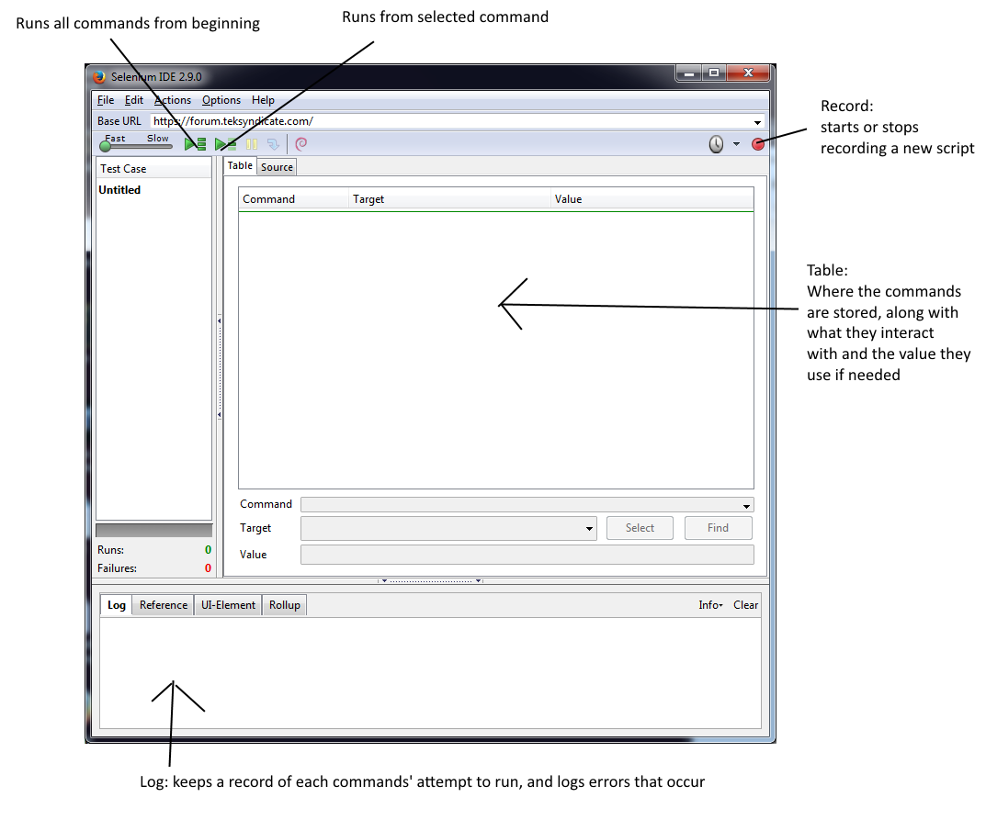
How to use the IDE

Slide 6
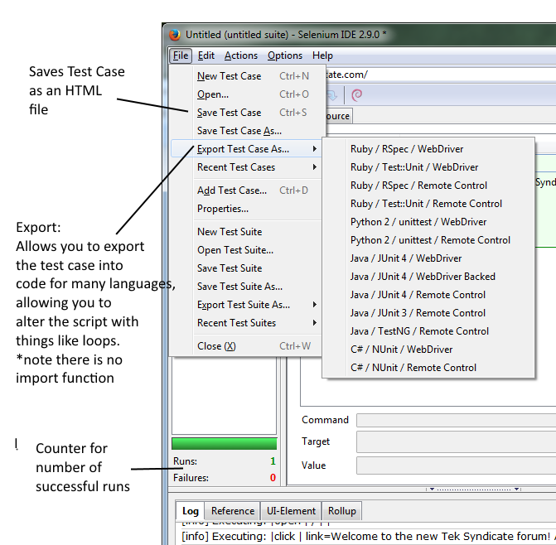
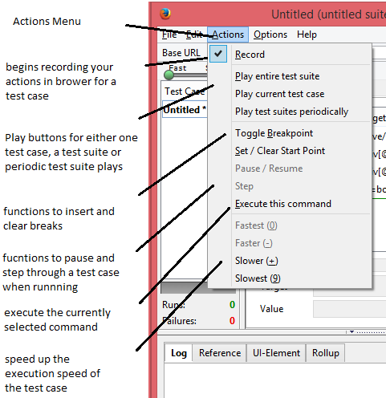
How to use the IDE cont.

Slide 7
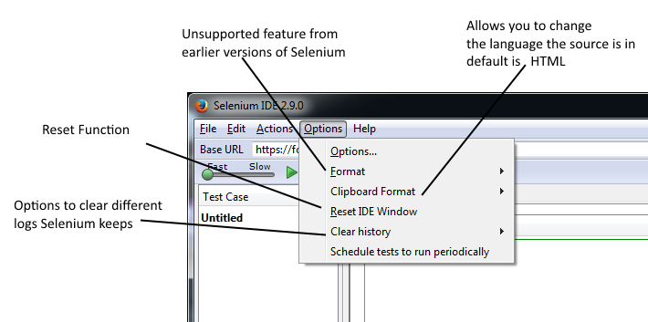
How to use the IDE cont.

Slide 8
Webdriver Functions
WebDriver is an API introduced into Selenium 2.0, replacing the outdated RC (Remote Control).
WebDriver is used to write automated tests, attempting to mimic a user using a website by interacting directly with the HTML of the specified website.
Automated tests for WebDriver can be written in many different languages such as Java, C#, Python, Ruby, PHP, Perl, and Javascript.
Supported browsers are IE, Chrome, Firefox, Opera, and HTMLUnit, through the use of each browsers driver for the WebDriver API

Slide 9
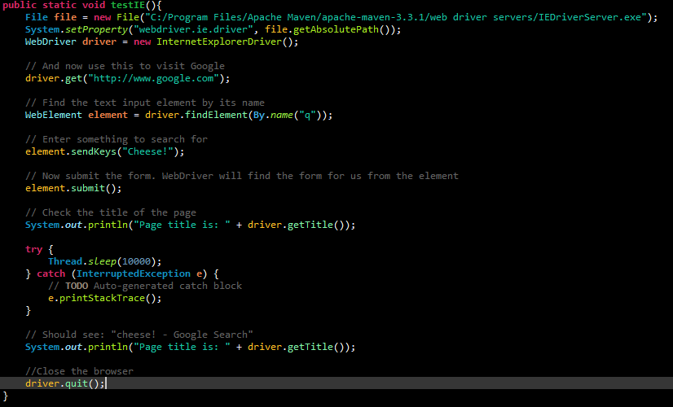
Simple WebDriver Test

Slide 10

Selenium Grid
What is it:
A distributed test execution environment
Allows for multiple tests to be run on different machines
Parallel test execution
Faster test cycles, reducing in less overall test time.

Slide 11
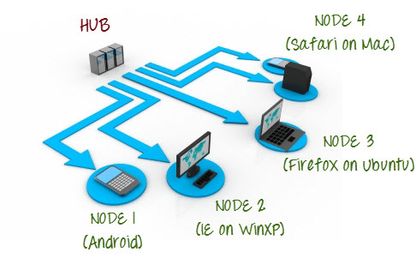
Selenium Grid (cont.)
Description:
Network of machines
Consists of a hub connected
to multiple nodes
Run test cases via hub

Slide 12
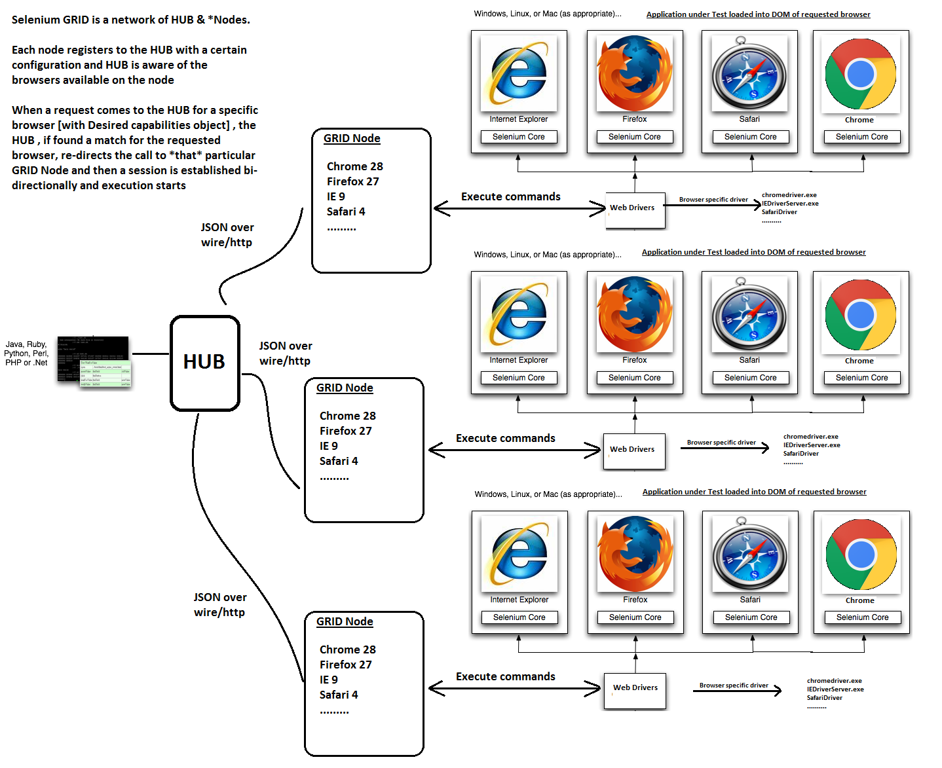
Selenium Grid (cont.)
What does it look like?

Slide 13
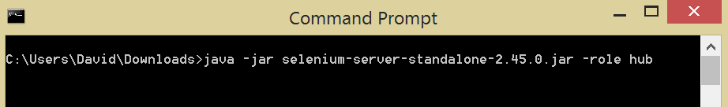
Selenium Grid (cont.)
Setting up the Grid:
Create a “hub” using selenium server jar file:
-This command creates the Grid hub

Slide 14
Selenium Grid (cont.)
Setting up the Grid (cont.):
2. Create a “node” and register it to the hub.
-You must specify what port you wish to use to communicate and...
-You must know the IP address of the hub and the port it is using to
communicate

Slide 15
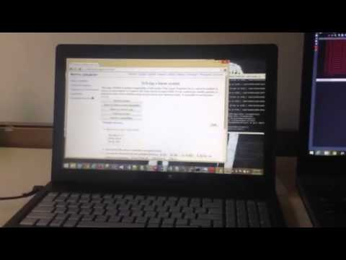
Selenium Grid (cont.)
Demo:
https://www.youtube.com/watch?v=Caf5wyIaqeA

Slide 16
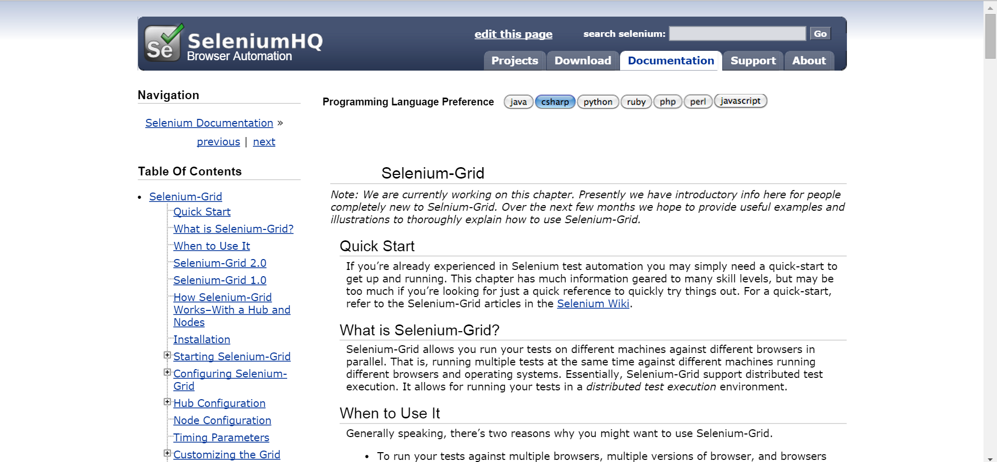
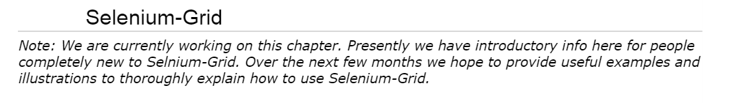
Selenium Grid (cont.)
Major Drawback:

Slide 17
Selenium Grid (cont.)
Although video tutorials and walkthroughs exist, the documentation for Selenium Grid is sparse.
Advanced instructions from Selenium do not currently exist.
This can be time consuming and extremely frustrating.

Slide 18
Wrap up
Selenium is easy to use, automated, and flexible.
It provides a wide range of features (as mentioned earlier) thanks to its open-source nature.

Slide 19
References
docs.seleniumhq.org/docs
Selenium Testing Tools (Beginner’s Guide)
stackoverflow.com
http://www.te52.com/wp-content/themes/wptellurium/tellurium/files/WhySeleniumIsntReallyFree.pdf
http://docs.seleniumhq.org/docs/07_selenium_grid.jsp
http://www.guru99.com/introduction-to-selenium-grid.html http://grid.selenium.googlecode.com/git-history/22ed3ff910401af083bf06a4d13514f4c6a623ca/src/main/webapp/how_it_works.html

